Slide 1




INCOGNITO MODE
HACKTOBERFEST 1.0

Slide 2






Online Cookbook
To solve the problem of missing ingredients which might lead to failure of the recipe and also solves the problem of not having a concrete budget.
Our solution aims to help beginner cooks and many bachelors living by themselves who want to try out some new dishes and also our solution helps them to cook basic dishes to survive.
Publishers and bookstores have noticed a positive trend in the past few years: Their cookbook sales are jumping, with cookbooks flying off the shelves. Always a popular category, cookbook sales have soared in the past three years. In 2021, cookbook sales were 42% higher than they were the year before. Since then, the upward trend has remained steady. Cookbook sales have not slowed down.

Slide 3




Solution
Our innovative business strategy combines profit-making with social impact to create a sustainable solution for the tech industry.

Slide 4


Key Features and Functionality
Our website allow users to easily access the recipes.
Gets rid of the boring UIs of the other cookbooks.
Efficient budget management.
Has a easy and interactive navigation.
Has a set of ingredients for each recipe.
.

Slide 5


Social impact
To spread the information of various recipes of various dishes to the foodie community.
We’ll measure our social impact through feedback forms and thorough social media pages.

Slide 6


Revenue Model
Our website would generate mainly in the form of subscriptions. We’ll be using freemium business model where we will be providing limited recipes and limited functionalities for free and if the user wants to know more we’ll be providing a premium version of the website.

Slide 7


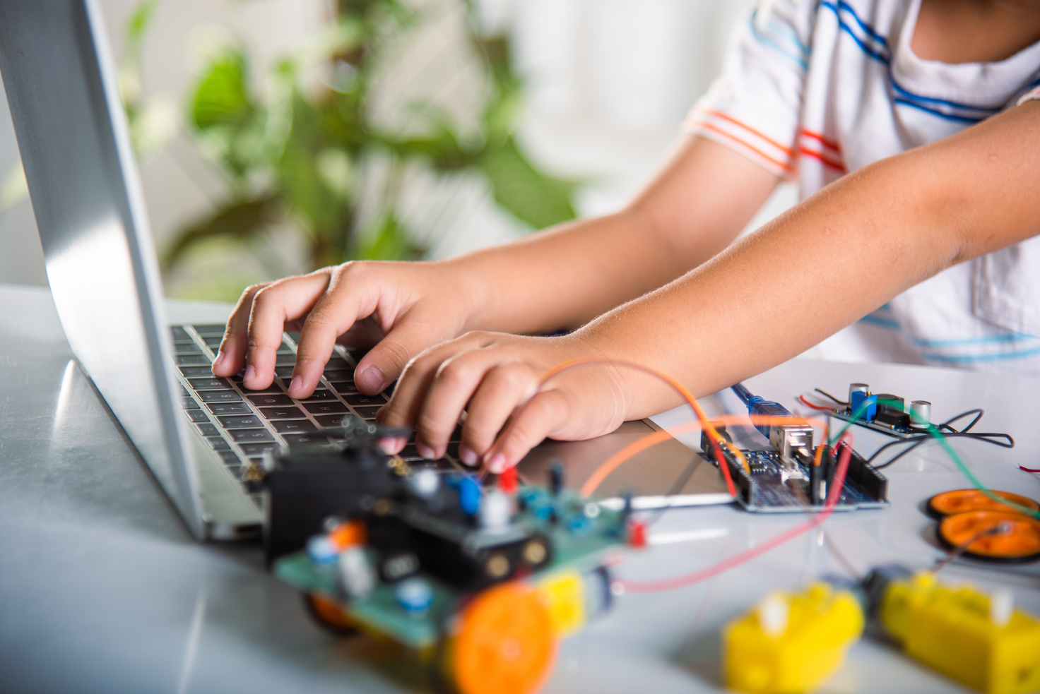
Technologies Used
OUR TEAM UTILIZES A VARIETY OF TECHNOLOGIES INCLUDING PROGRAMMING LANGUAGES LIKE HTML, CSS, JAVASCRIPT AND REACTJS, FOR BACKEND WILL BE USING MYSQL AS WELL AS TOOLS LIKE GITHUB AND AWS.

Slide 8

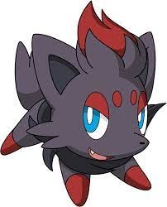
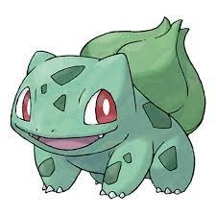

The Team
Praneeth Yeddu
Yavish Sahrawat
Kushal
Ramwani
Leader
Supporter
Mental Supporter

Slide 9


Thank You
HACKTOBER FEST

